Slide 1




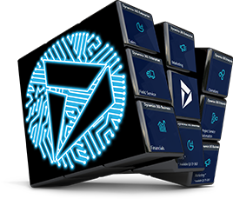



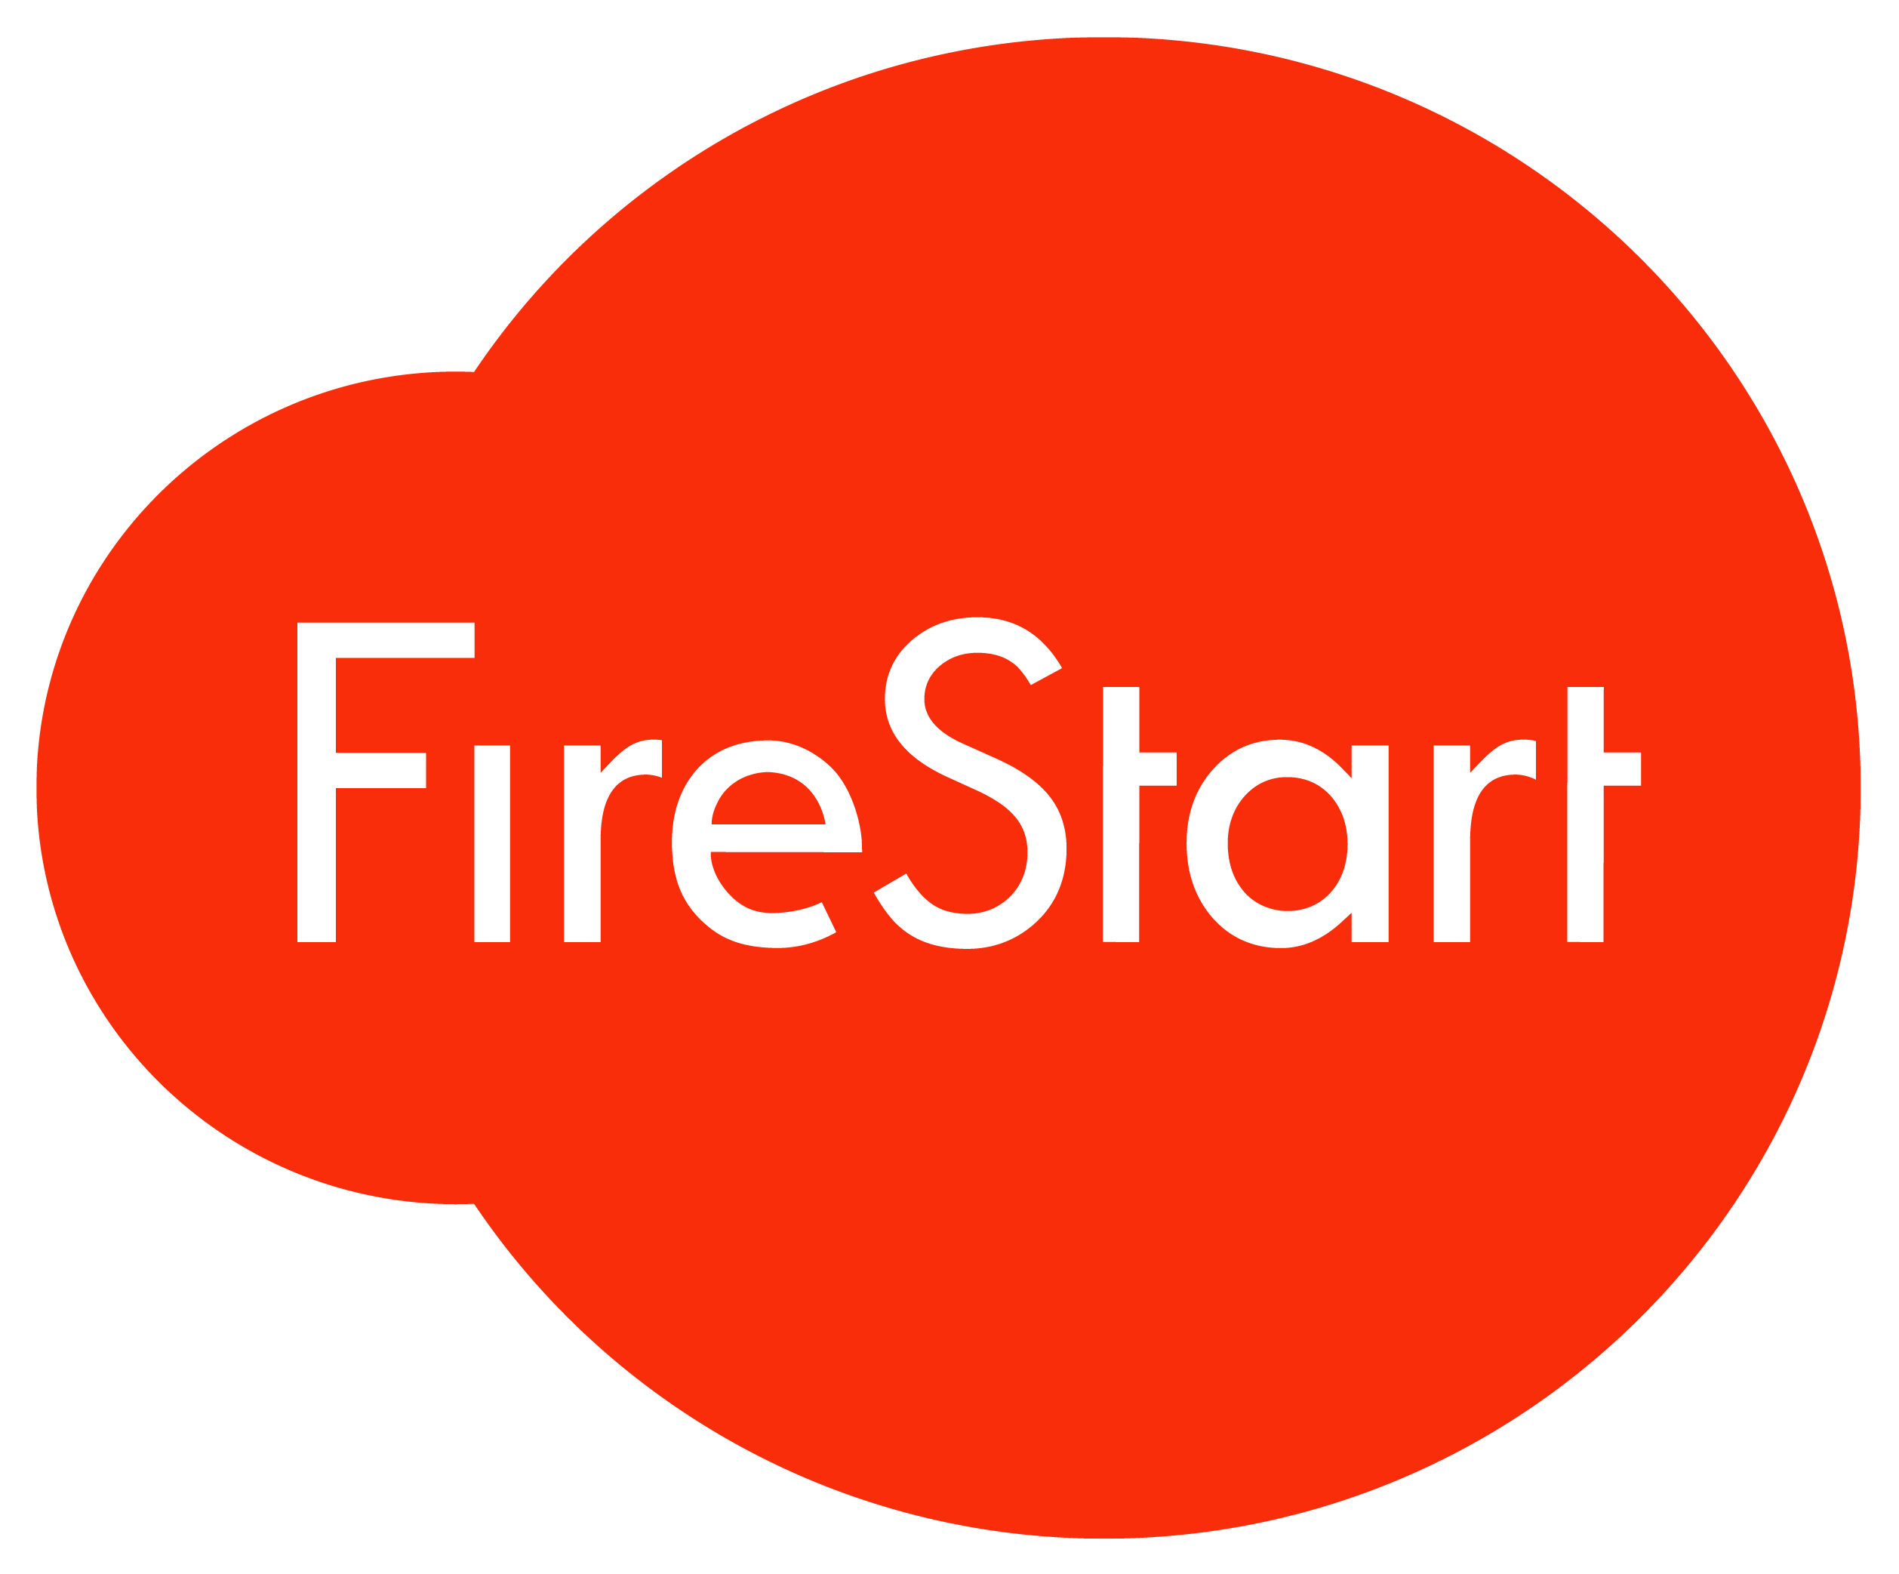
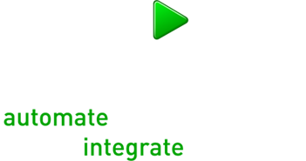
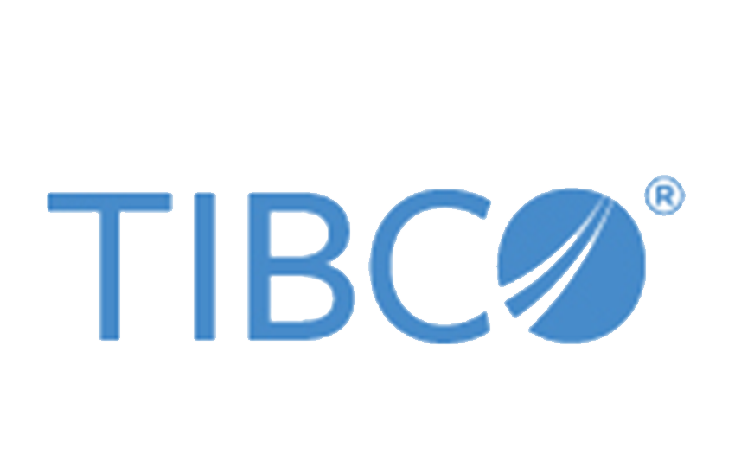






Slide 2
TDD for Dynamics 365 / CDS
What’s new

Slide 3
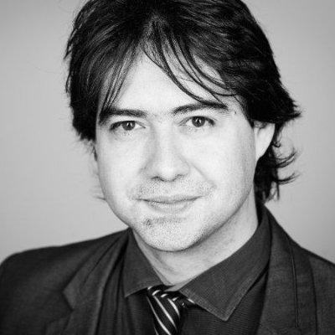



About Me
Jordi Montana
Founder at https://dynamicsvalue.com
Author of #FakeXrmEasy
2 x Microsoft Business Applications MVP
Passionate about OSS and Dev technologies
@jordimontana http://www.linkedin.com/in/jordimontana

Slide 4
Agenda
Why unit testing / test automation?
Super brief intro to DevOps
Test Automation using OSS technologies
What’s new in TDD for Dynamics 365 CE
https://github.com/jordimontana82/365saturday-manchester-2019

Slide 5
Why unit testing / test automation?

Slide 6
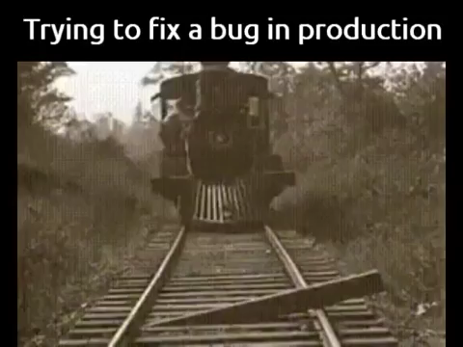
Why unit testing / test automation?

Slide 7


What is DevOps?
DevOps
Plan
Code
Build
Test
Release
Deploy
Monitor
Fast
Continuous Business
Value
Automation

Slide 8
Test Automation
Unit Testing
Integration Testing
UI Testing
System Tests
Trigger from Build
Visual Studio / Build
CRM Env. (QA)

Slide 9
Unit Testing
.NET
FakeXrmEasy (NuGet)
Unit Testing
fakexrmeasy (npm)
xrm-mock (npm)
Javascript / Typescript
PCF controls

Slide 10
What’s new…?
New messages and features added to #FakeXrmEasy
FakeXrmEasy.js completely rewritten to remove edge.js dependency (give it a try… pull requests are welcome :P)
It runs exclusively in the node process only now
Enables not just client-side, but server side unit test testing against Web API (i.e. only if you are brave enough to use Node.js for server side applications against CDS :P)
PowerApps Component Framework CLI: React-based… although react components are supported… no support for .tsx based ones yet.

Slide 11
What’s new…?
DEMO

Slide 12


Dynamics 365 Community
Join the Dynamics 365 Community, where you can interact with your peers and Microsoft Dynamics 365 experts. You can get answers to your questions by posting questions in the forums, starting discussions, reading informative blog articles, and watching how-to videos.
https://community.dynamics.com
Benefits
Participate and help build a pool of knowledge that’s accessible by members at any time!
Expand your network by engaging with peers
Involvement
Need help? Ask questions and join in on business or technical discussions in the forums
Share your expertise by hosting a blog or syndicating your existing blog
Recognition
Earn badges for participation and engagement
Become a Community Star and earn appreciation from peers
Join Today!
Get answers, find inspiration, connect with others
Free membership
Any questions? Email us at dlcommed@Microsoft.com

Slide 13

Social
www.365portal.org
Twitter: @Dyn365Community
Linkedin: @365-Saturday
Hashtags
#D365Manchester #365Saturday #msdyn365
Wifi: TBC
Pass: TBC
Community.Dynamics365.com

Slide 14
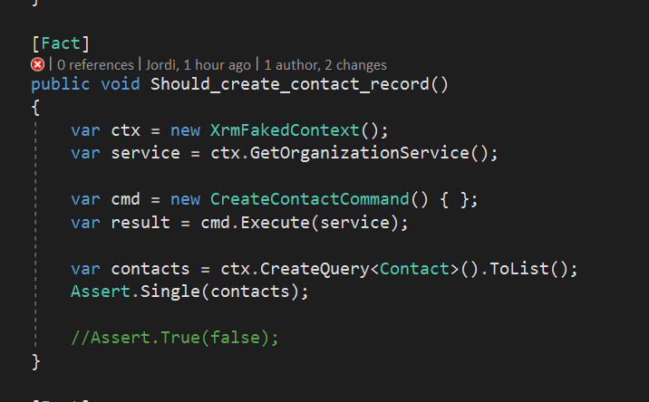
Demo screenshots

Slide 15
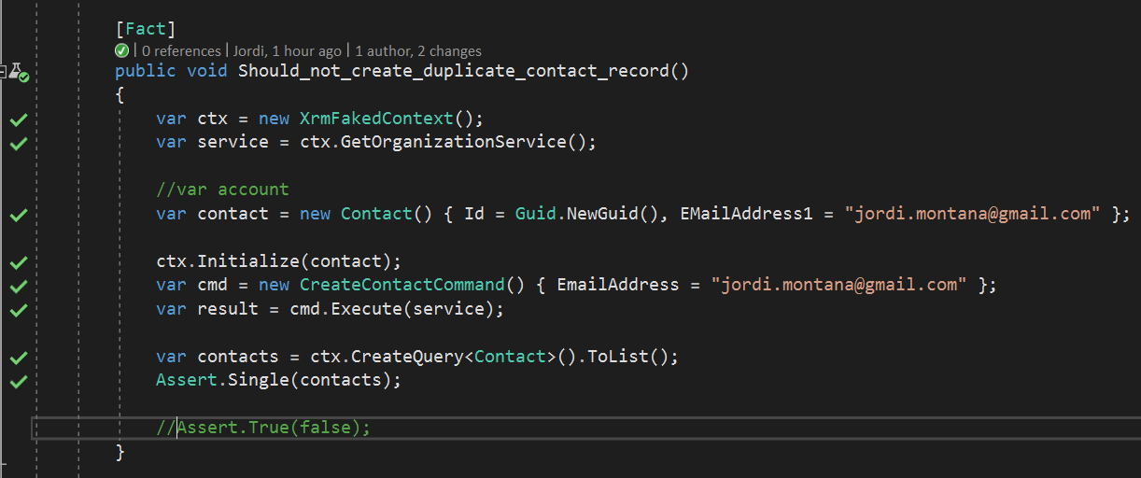
Demo screenshots

Slide 16
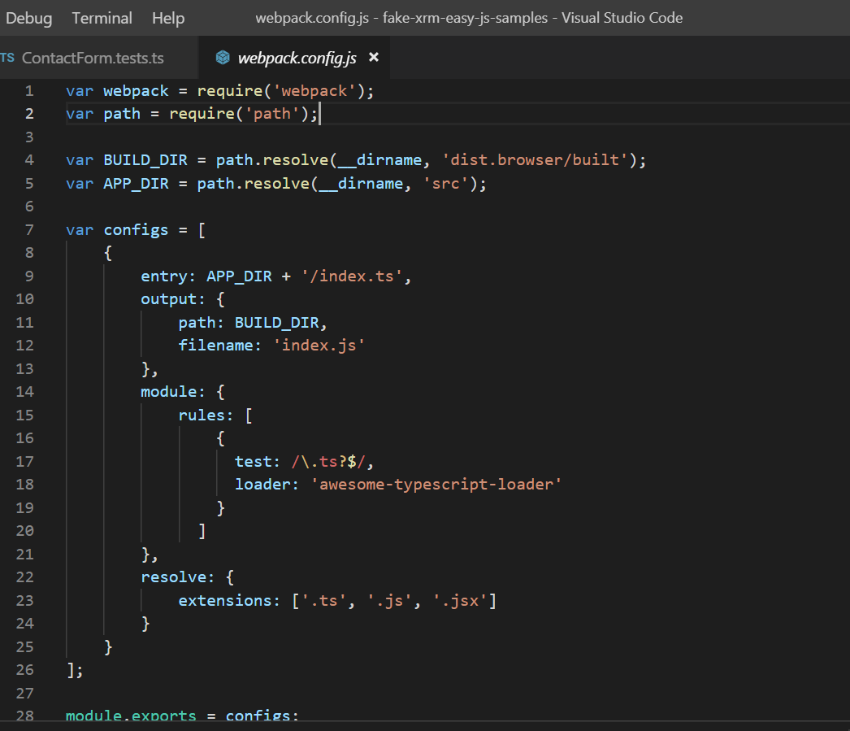
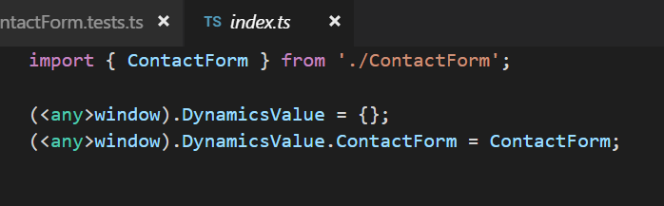
fake-xrm-easy setup + webpack

Slide 17
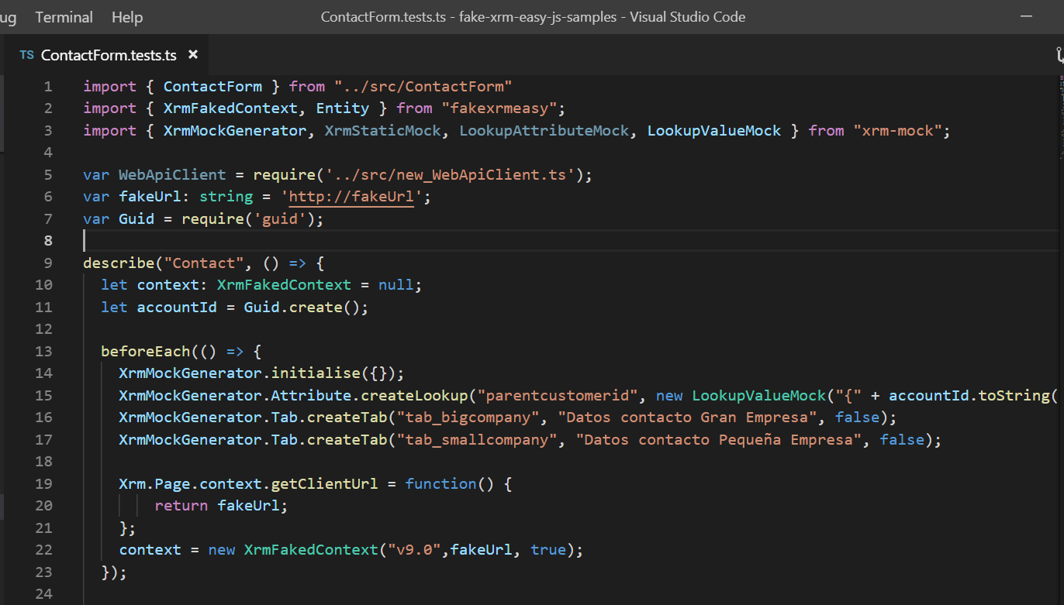
fake-xrm-easy + xrm-mock example

Slide 18
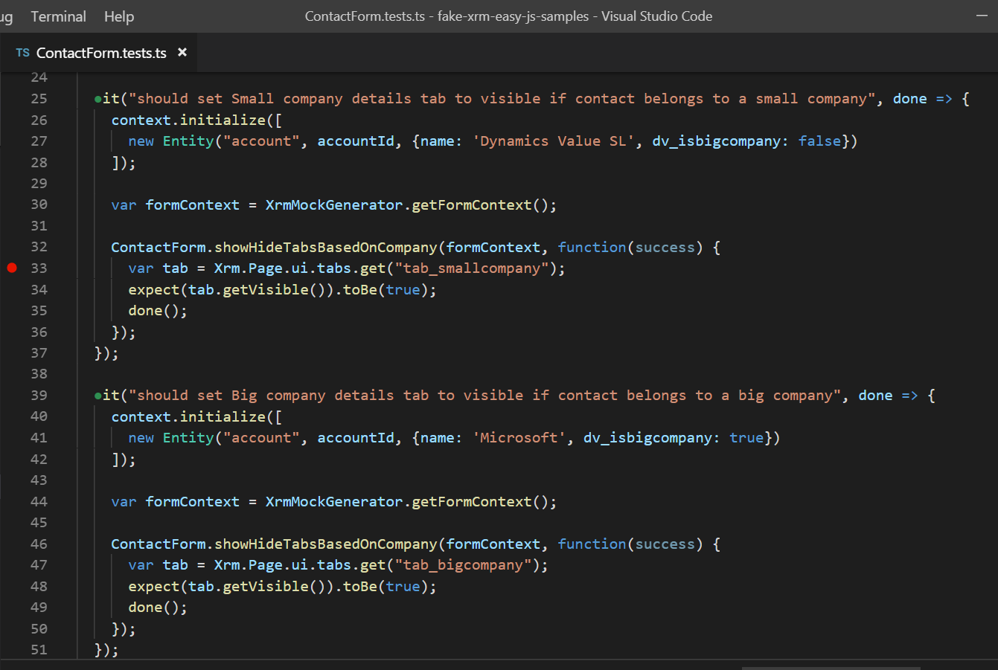
fake-xrm-easy + xrm-mock example

Slide 19
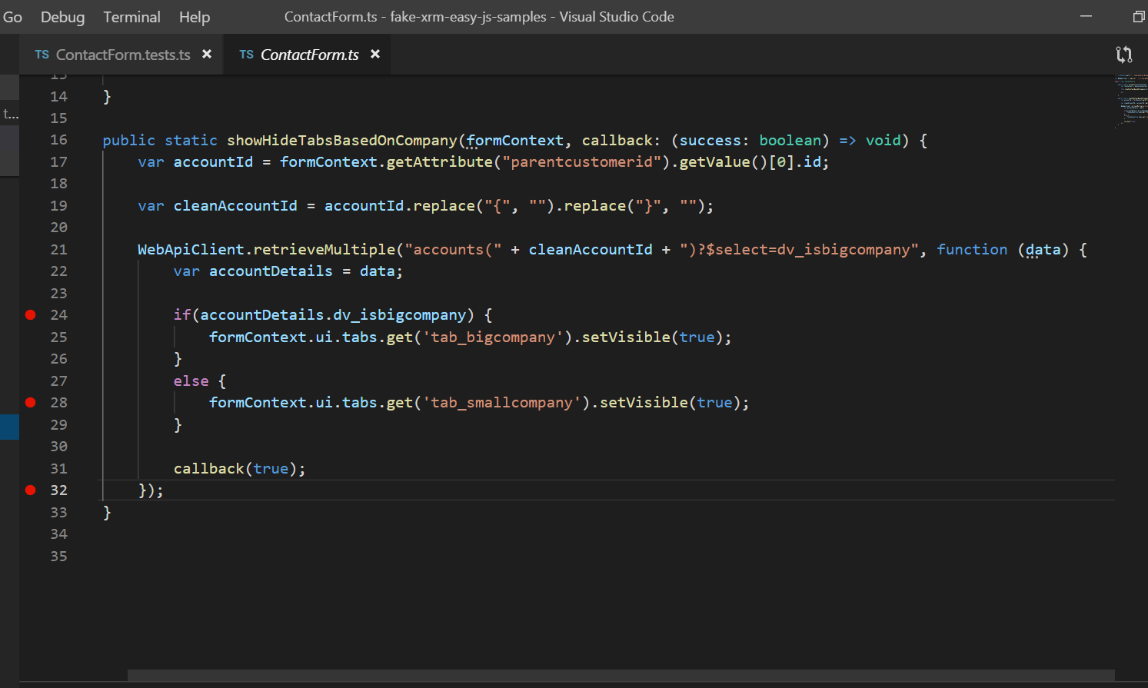
fake-xrm-easy + xrm-mock example

